Slide 1
Stock Market Prediction using Machine Learning

Slide 2
Agenda
Use Case
Process
Feature Engineering
Algorithms & Modeling
Challenges

Slide 3
Use Case
Predicting movement of a Stock for next day
Predict the next day close price for a Stock
Or Predict whether next day change will be positive or negative
Hypothesis - Short term Stock Price movement (1-5 days) greatly depends on previous days-months price, technical indicators, movement of Market Indices and Derivative outlook of Stock in future.
Long term prediction depends more on fundamentals of the company and macro economics of the industry & country.

Slide 4
Process
Gather Data
Data Wrangling
Modeling
Accuracy analysis
Real time Test and Fine tuning

Slide 5
Feature Engineering
Market Data (4 years of historical data as samples)
daily close price, volume, change from previous day
Indian Market Index Nifty daily close
60 days of close price for each sample
Moving averages for 5,10,20,50,100, 200 days
Technical Indicators
Two most commonly used indicators by technical analysts -
MACD flag– calculate MACD line and Signal. Define flags when MACD and signal lines crosses each other.
RSI flag – calculate RSI points and based on last 3-4 days values of RSI define a flag.
Derivative Data
Open Interest – calculate OI and change in OI
PCR Ratio - calculate Put-call ratio

Slide 6
Algorithms & Modeling
Trying both regression and classification
Algorithms used
Linear Regression
Random Forest
Decision Tree
Gradient Boosting
Artificial Neural Network (ANN)
Accuracy
Shows high accuracy due small percentage change in price on daily basis
Actual classification Prediction is 50-55% accurate
Target is 70%+

Slide 7
Challenges
Accuracy with classification is low (55%)
Results slightly better than manual analysis without ML
Is data not good enough to predict or usage is wrong
How to understand the black box logic modeling is making so that we can tweak appropriately
Would tweaking parameters for Algorithms make a difference

Slide 8
Appendix

Slide 9
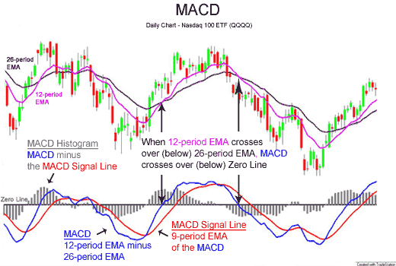
Technical indicator: MACD

Slide 10
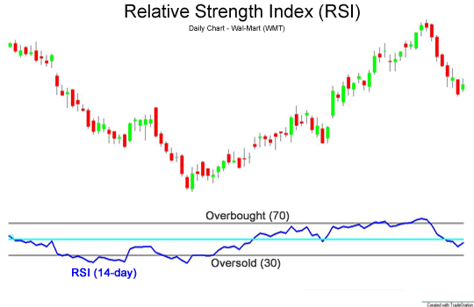
Technical indicator: RSI

